Slide 1
POVs and Experience Prototyping
CS147 Winter 2021

Slide 2
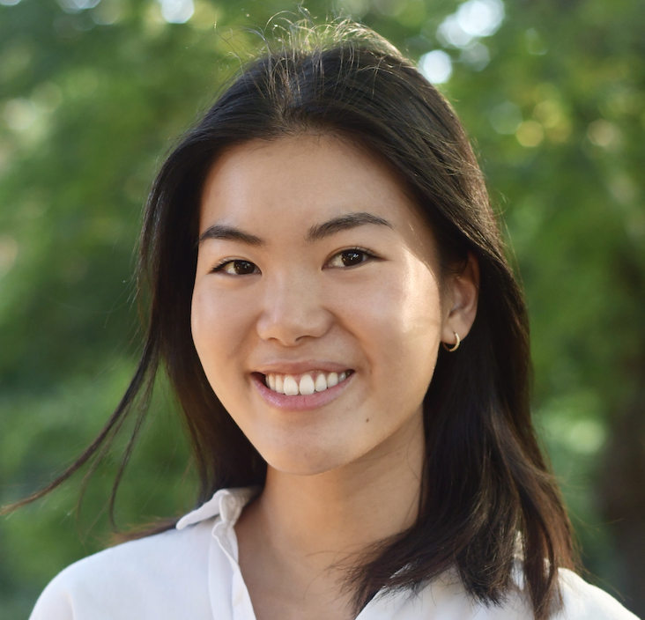

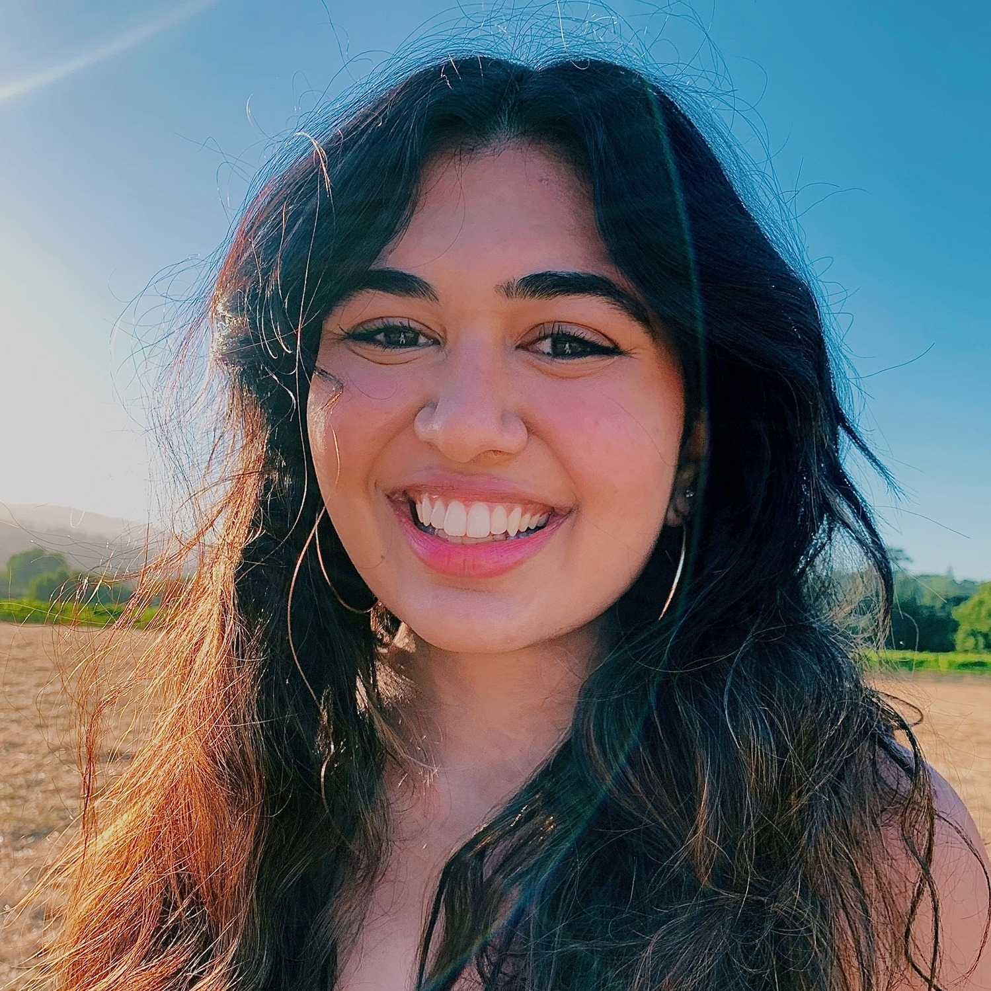

01 Meet the Team
Amy Z.
Tara P.
Anooshree S.
Platon M.
Senior
Computer Science
Boston, MA
Senior
Symbolic Systems
Oakland, CA
Senior
Computer Science
San Jose, CA
Junior
Symbolic Systems
NYC, NY

Slide 3
02 Domain
New Grad
Loneliness
Housing
Intentionality
Dating
Notes:
As we mentioned last week, our needfinding was centered around these four areas. This week we really dove deeper into the areas of loneliness and intentionality as these were areas that kept coming up as a common theme throughout all of our interviews and seemed to be where the greatest need is.

Slide 4
03
Initial POV
Notes:
Tara

Slide 5
Initial
POV
We met…Hadley, a 24-year-old college grad living in NYC.
We were surprised to notice…she wants to make her major life decisions informed by where her broader social network is going and what they’re doing.
We wonder if this means…she prioritizes avoiding loneliness and maintaining community by following social cues.
It would be game-changing to…let people see the social cues/future plans of their community.
Notes:
This was our initial POV. After reading Morgan’s feedback, we learned that we needed to add more information to the initial “we met” statement, focus on action rather than desires, and focus on Hadley’s beliefs in the “we wonder” statement.

Slide 6
04
Additional Needfinding
Notes:
Amy and Platon to do for people they interviewed (one separate slide per person)

Slide 7

“There was a closeness with people at Minerva [her university] that made it ok to do very casual activities. It’s not like that post-grad.
I’m not gonna invite someone I don't know super well to go grocery shopping with me.”
Nebraska Grayson
23, Edgewood, PA
Freelancer and Political Organizer
Notes:
Amy
We also interviewed Nebraska who is one year post grad from a non traditional international university called Minerva. She is currently living at home and is working as a freelancer and political organizer. She had this really interesting quote about the kinds of activities that she did in college vs in post grad life and importantly, with whom did she do these activities: close friends or acquaintances.

Slide 8

“Worried about having friends in the area but not sure when people are busy”
“If you dont settle on the activity you don’t know how much time it will take so that's another problem”
Rachel Cheng
22, Princeton, NJ
Working at McKinsey
Notes:
Platon

Slide 9
05
Revised POVs
and HMWs
Notes:
Anooshree

Slide 10
POV 1
We met Will, a recent college grad working in consulting who recently moved to SF.
We were surprised to notice he often watches Netflix alone after work even though he desires social interaction.
We wonder if this means the activation energy of socializing with others prevents Will from making plans with friends.
It would be game-changing to help Will find a low-effort way to make plans with friends after work.
Notes:
HMW help Will find social events that entice him to make plans?
HMW make seeing friends a zero-effort task?
HMW decrease the activation energy required to make plans with a friend?
How might we pair friends and activities for Will?
How might we make planning as relaxing as watching netflix?
HMW increase Will's energy towards planning social interaction?
HMW make post-grad socializing mimic college socializing (low effort and natural)?
HMW make planning social interactions fun?
HMW create an entire weeks worth of activities for will to invite a friend to do?
How might we make going from work to social events a seamless transition?
HMW get Will's friends to make plans with him?
HMW make Will not crave social interaction?
HMW allow Will to better balance his alone time and social time?
HMW remove the need to feel bad about not socializing in the first place?
HMW make planning more empowering for will?
HMW make netflix and sleep more sociable in the first place?
HMW find shared times between friends, create activities, activate the two?
How might we automatically schedule in social events?

Slide 11
POV 2
We met Nebraska, a recent Minerva grad working as a freelancer/political organizer living in between cities and home.
We were surprised to notice she feels pressure to plan unique/exciting activities when hanging out with acquaintances.
We wonder if this means she bonds more easily with acquaintances during unique activities.
It would be game-changing help Nebraska find exciting activities in her city.
Notes:
HMW make Nebraska's casual hangouts just as exciting as an art gallery or concert?
HMW increase the number of exciting activities in Nebraska's city?
HMW take advantage of her work communities to find bonding activities?
How might we make sure planning is equally shared between Nebraska and her acquaintances?
HMW make it more exciting to spend time with acquaintances instead of stressful?
HMW make Nebraska comfortable interacting casually with acquaintances?
HMW help Nebraska seamlessly find and plan to do the most enticing activities in her city?
HMW create events that are exciting for nebraska?
HMW get access to what activities people who live in the city usually do?
How might we planning while frequently moving less intimidating?
HMW decrease Nebraska's social anxiety around seeing new friends?
HMW automatically connect Nebraska and acquaintances with mutually interesting activities?
HMW make it easier to socialize and connect with acquaintances without exciting activities?
HMW get Nebraska excited by doing boring things?
How might we replicate the social ease of being around old friends?
How might we create community from acquaintances?
HMW give Nebraska more chances to hang out with her old, close friends?
HMW make it easier for Nebraska to feel comfortable with new acquaintances?
How might we make seeing acquaintances more financially accessible?
HMW bring the exciting activities to Nebraska instead of the other way around?
HMW find out what people have done in the past and share those experiences with Nebraska?

Slide 12
06
Top 3 HMWs
Notes:
Amy

Slide 13


How might we…
Make planning as relaxing as watching Netflix?
Make planning also a space for bonding with acquaintances?
Remove the need to feel bad about not socializing?
Notes:
From Will, we particularly liked the parallel between wanting to make planning as relaxing as watching Netflix as it gave us a more concrete experience and feeling to base our brainstorming off of. We also liked the perspective of decreasing some of the pressure that seems to be inherent from all of our needfinding in socializing as a post grad. From Nebraska, we were interested in the idea of involving acquaintances in the planning process to remove some of the awkwardness of getting to know someone.

Slide 14
07
Solutions and
Experience Prototypes
Notes:
Platon
Anooshree – self care

Slide 15
Solution 1
Propose “solo dates” to new grads to encourage self care and development alone after work.
Assumes that new grads want guidance as to how they spend their alone time. They will not find suggestions overbearing.

Slide 16

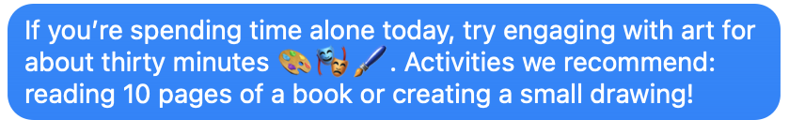
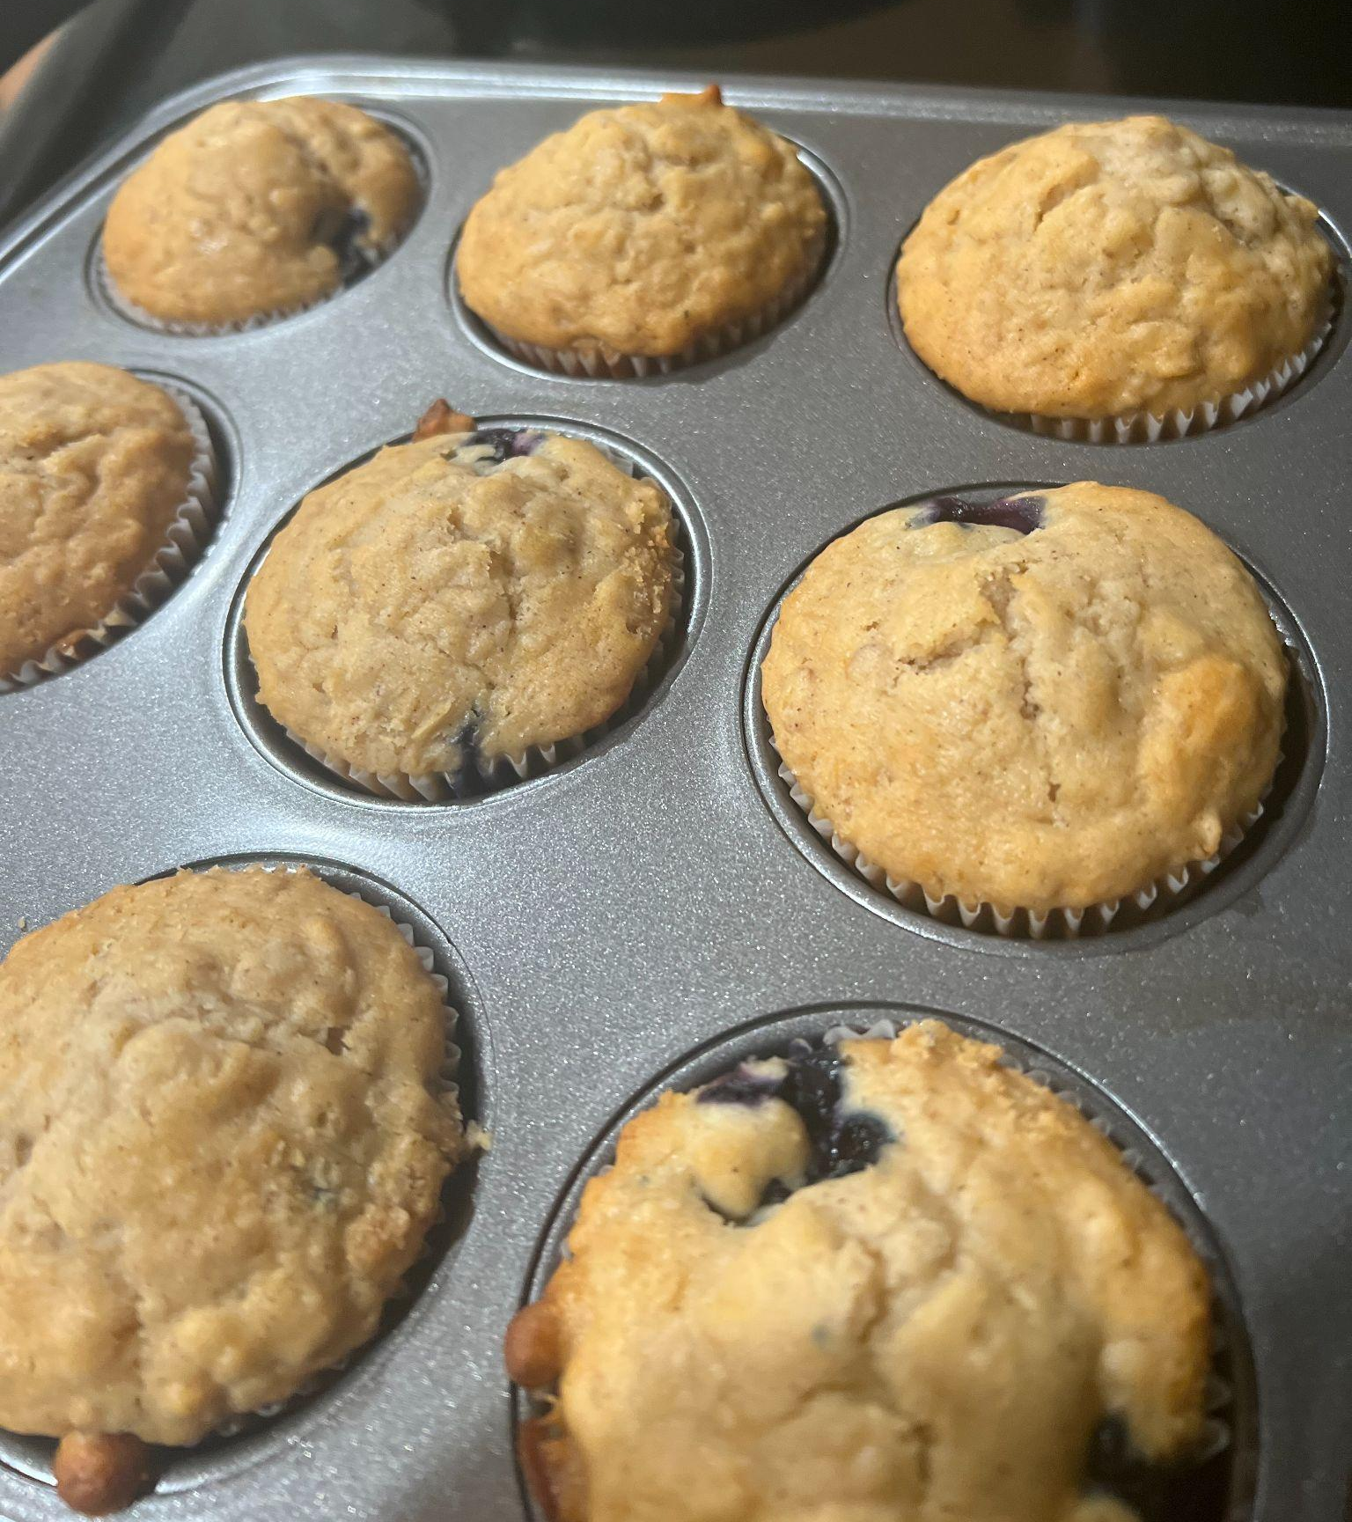
Experience Prototype 1
We wanted to test if proposing ideas for self care was appealing to new grads, and if they would follow through with suggestions.
Sent a text to several new grads recommending a broad, achievable activity
Received picture of activity, once completed.

Slide 17
Results
Things that worked:
those that completed the task also noted that they enjoyed spending meaningful time alone
ideas following vague prompt were creative and specific
Things that didn’t work:
40% response rate to the original prompt, may have been lost among other notifications
Surprises:
participants asked for permission to interpret the prompt in their own way
New learnings:
Those that participated didn’t report feeling obligated to, or that the tasks were tedious.

Slide 18
Solution 1I
Allow new grads to scroll through compatible free times with friends and get options for activities suitable for that time
Assumes that new grads want agency when making their plans (and that scheduling and planning are the core barriers to socializing)
Notes:
The second solution that we identified was to allow new grads to scroll through compatible free times with friends and from there get options for activities suitable for that time. The core assumption that we are testing here is that scheduling and planning are the core barriers to socializing and specifically that new grads want agency when making their social plans.

Slide 19
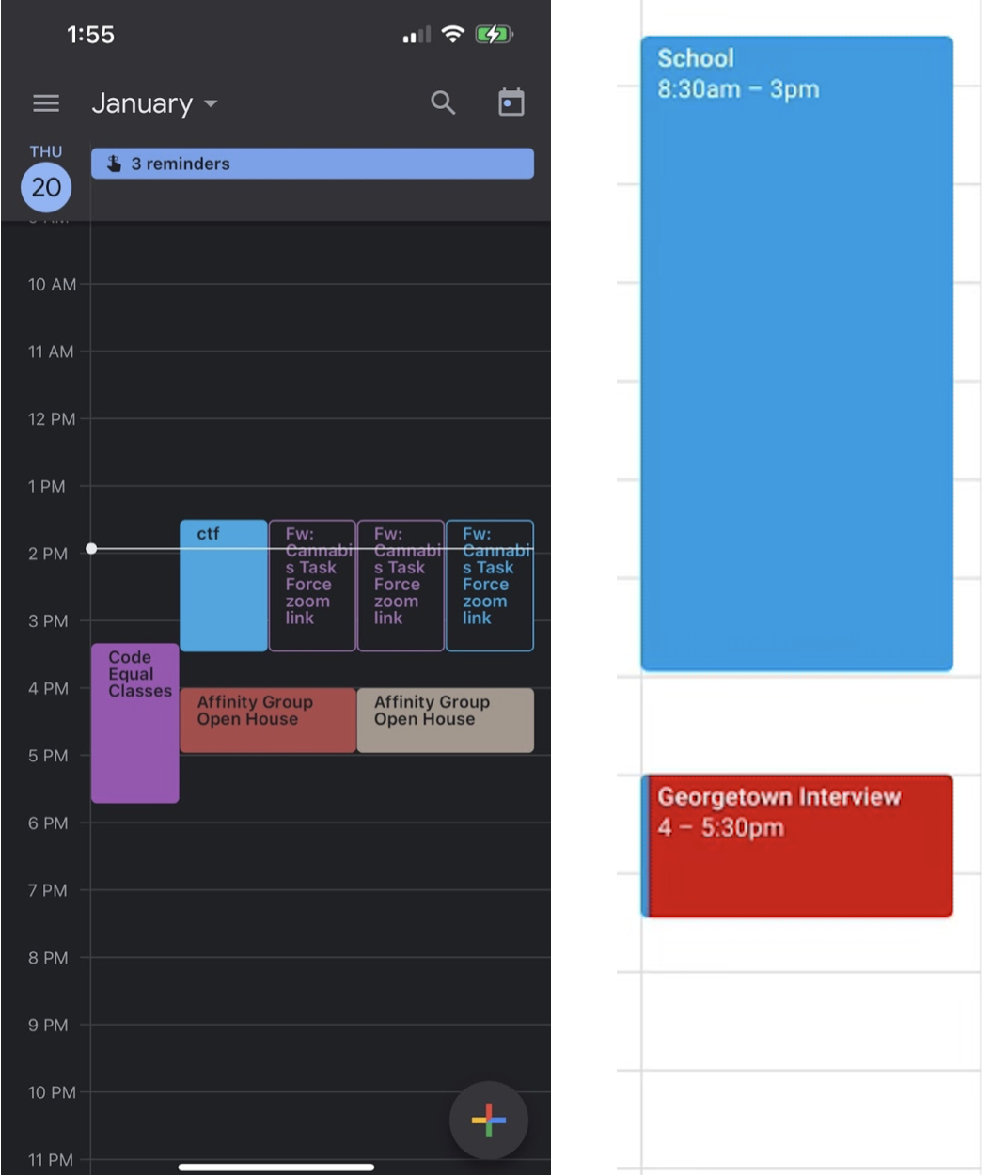
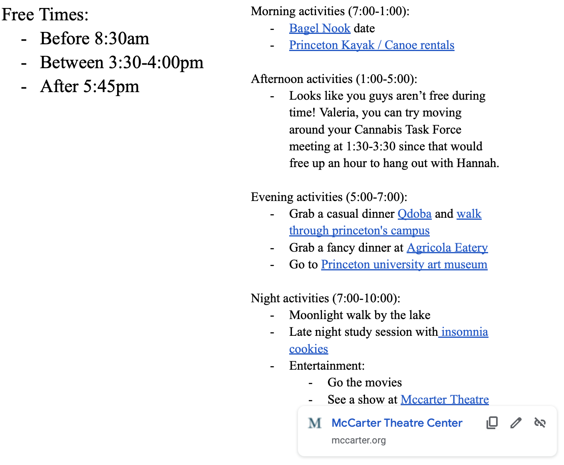
Experience Prototype 1I
Compiled Google Calendars
Find overlapping times and curate activities with hyperlinks
Notes:
Platon put the results at the end of the last arrow
Our experience prototype for this idea consisted of collecting Google calendars from a set of friends and then compiling their free times onto a doc. On this same doc we also gave them a list of suggested activities for the time slots that they were free along with hyperlinks to the activities and suggestions for how to free up more overlapping time.

Slide 20
Results
Things that worked:
Users appreciate the variety of available times and activities and loved the flexibility of suggestions
Things that didn’t work:
Analysis paralysis. One user felt like it was hard to make a choice because there were too many options.
Surprises:
Users love flexibility but are nervous with too many options
New learnings:
Need to find a comforting way to display the right amount of information.

Slide 21
Solution 1II
Once a week, notify two new grads with a compatible free time and suggested activity
Assumes that a single notification is enough to motivate socializing between two friends
Notes:
The second solution that we identified was to allow new grads to scroll through compatible free times with friends and from there get options for activities suitable for that time. The core assumption that we are testing here is that scheduling and planning are the core barriers to socializing and specifically that new grads want agency when making their social plans.

Slide 22
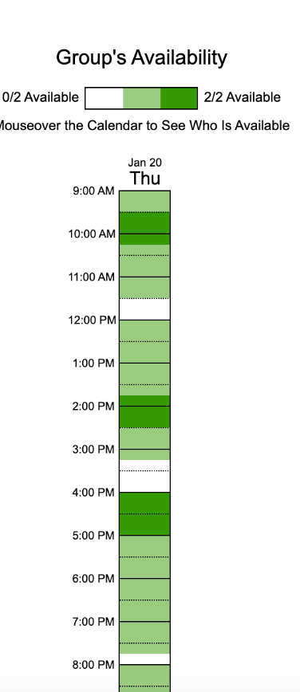
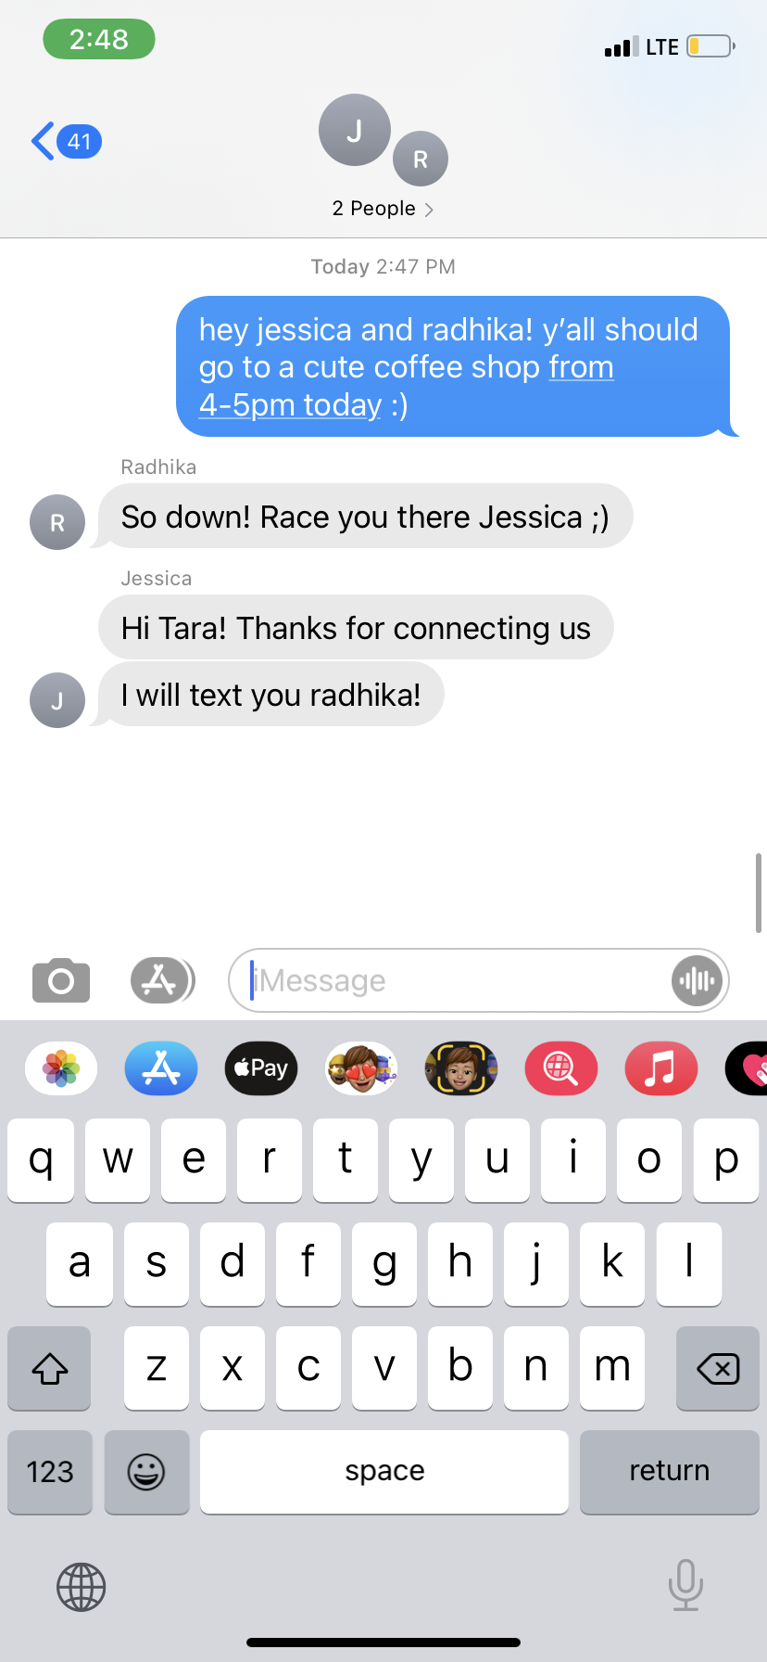
Experience Prototype 1II
We wanted to test if proposing a specific time and activity for socializing effectively decreased the activation energy needed for two new grads to hang out.
Used When2Meet to identify overlapping free time between two friends
Notified friends with a suggested time and activity
They arranged to meet up!

Slide 23
Results
Things that worked:
low activation energy to hang out with a friend after work
friends who hung out reported that the process of planning was low-stress and easy
Things that didn’t work:
some participants ignored the notification because the time or activity was not optimal
Surprises:
reported “free time” is not always actually time during which a participant is interested in socializing
New learnings:
participants have some interest in selecting their own optimal time/activity from options
Notes:
Main takeaways are that:
sending a single notification makes planning very easy and low-stress for users
however, it also removes any options for choice between different activities/times
sometimes, participants may prefer a specific time among all their technically “free time” or would prefer a specific activity that we cannot predict
therefore, it seems like altering this solution to incorporate more choice between different options would be ideal

Slide 24
08
Solution

Slide 25
5-9
Let's be intentional post work!
Whether you want to engage in
Self care
Socializing
Or do nothing at all
WE CAN HELP :)

Slide 26
09
Summary

Slide 27
5-9
Our interviews allowed us to revise our POVs which streamlined our HMW that allowed us to brainstorm better solutions
Our experience prototypes were very helpful in understanding what worked and what didn't work.

Slide 28
10
Q & A

